Slide 1
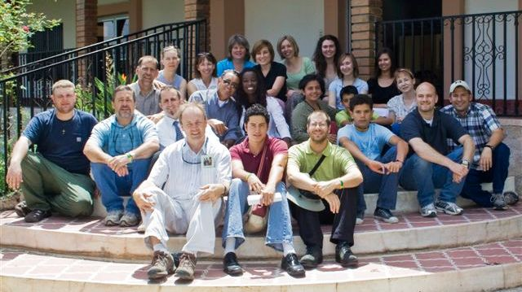
Mission To Honduras 2008
Jon Knapp
Ted Whiteman
Brenda Whiteman
Mary Hunter
Meagan Dahlgren
Jessica O’Donel
Matt O’Donel
Brian Wiggs
Brian Nelson
Susan Bradley
Debbie Boyle
Brad Butcher
Raechel Cowell
Cara O’Halloran
Amy Nielson
Naida Alcime
Rick Lotero
Bessy Lotero
Brigitte Syvestre
Gibson Syvestre
Drew Smith

Slide 2
Matthew 28:19-20
“Therefore go and make disciples of all nations, baptizing them in the name of the Father and of the Son and of the Holy Spirit, and teaching them to obey everything I have commanded you. And surely I am with you always, to the very end of the age.”

Slide 3
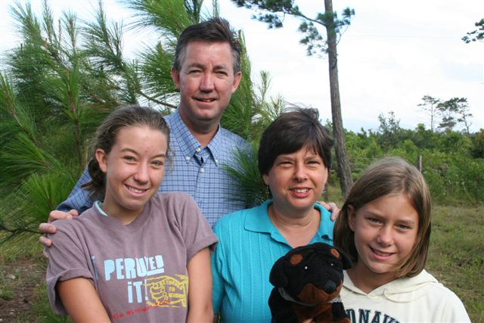
The O’Connors

Slide 4
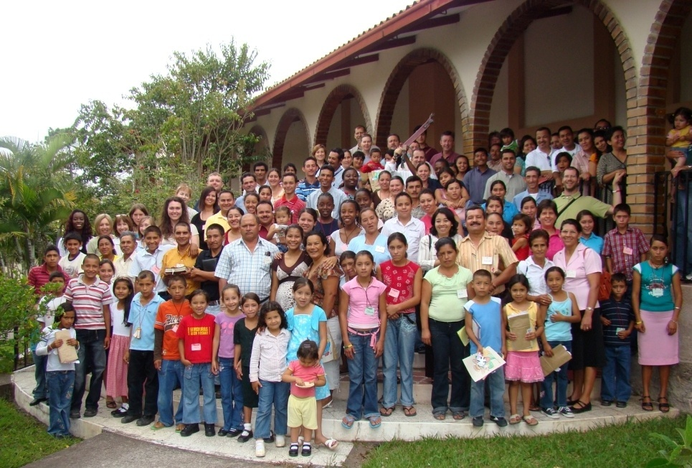
Pastor’s Conference

Slide 5
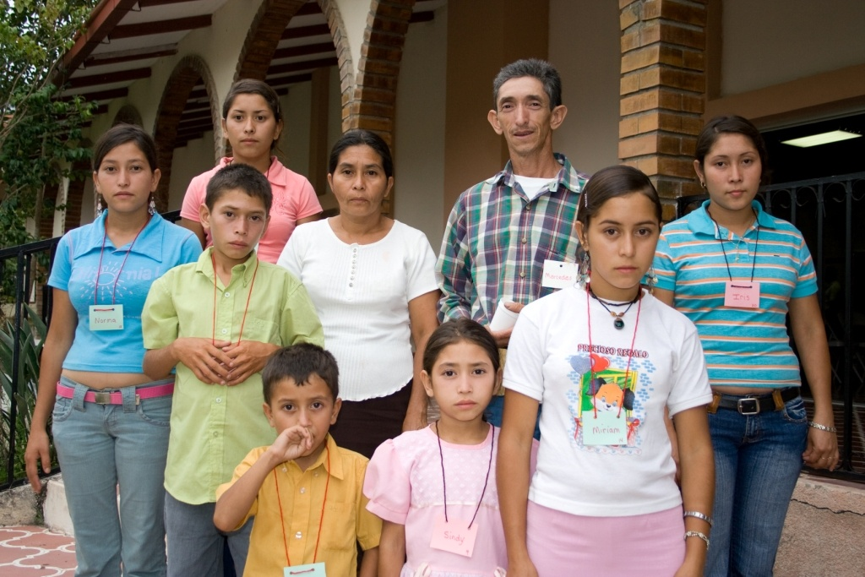
Pastor’s Conference

Slide 6
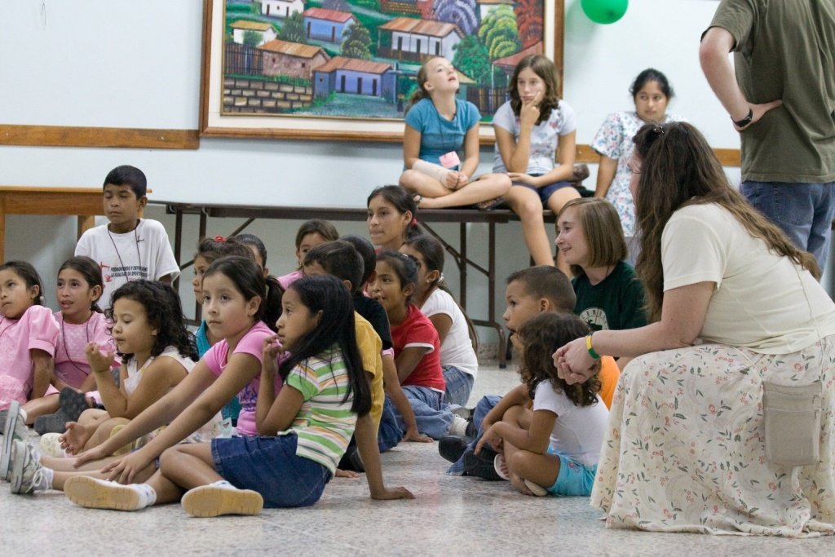
Children’s Ministry Pastor’s Conference

Slide 7
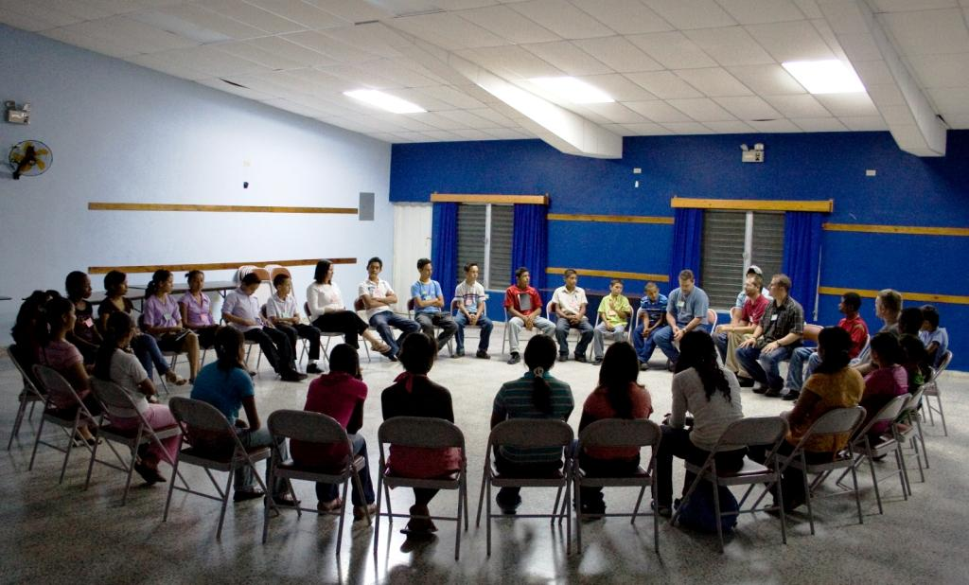
Youth Ministry Pastor’s Conference

Slide 8
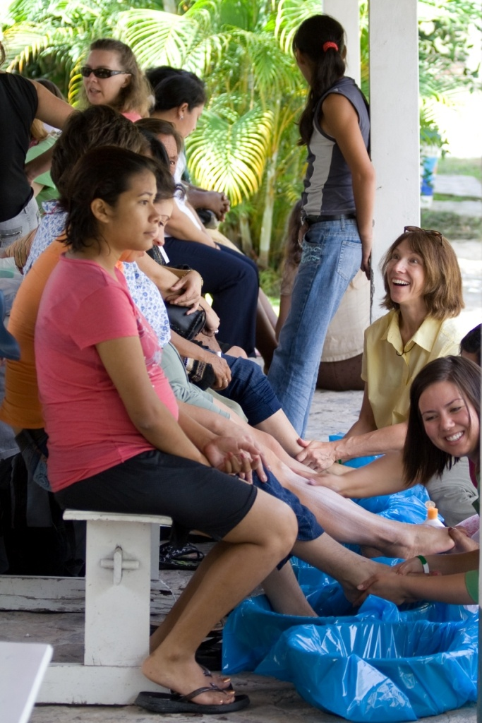
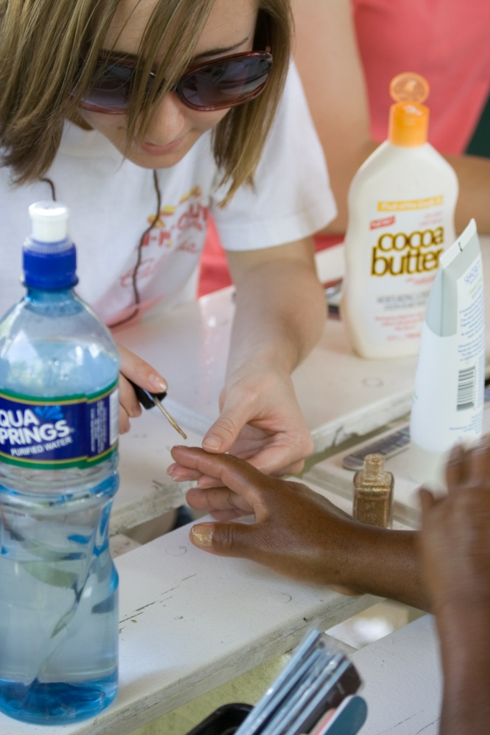
Women’s Ministry Pastor’s Conference

Slide 9
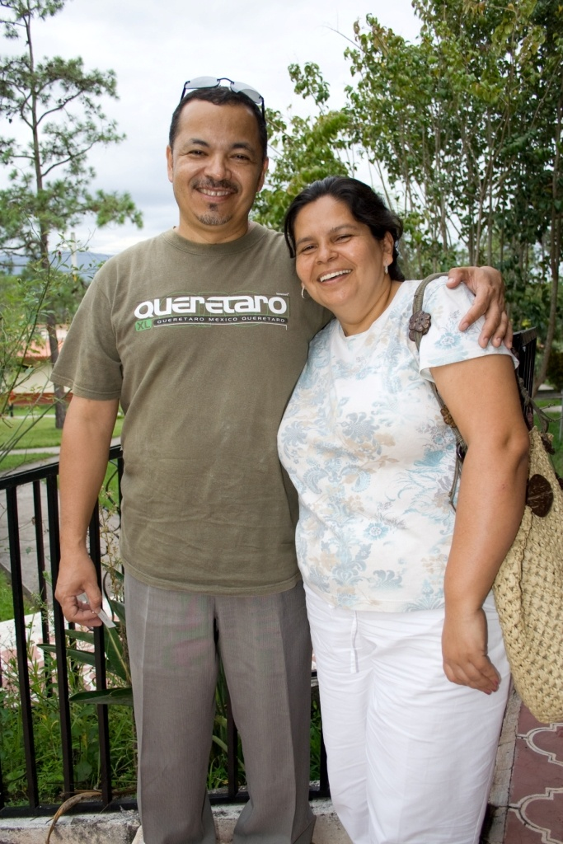
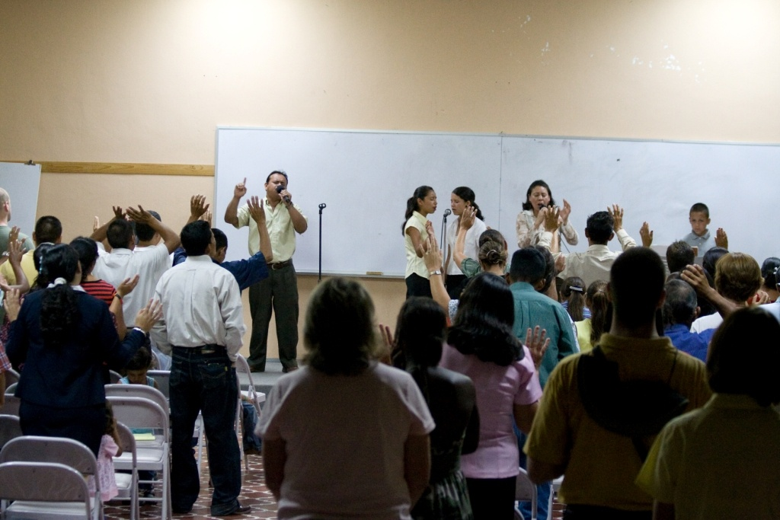
Pastor’s Conference

Slide 10
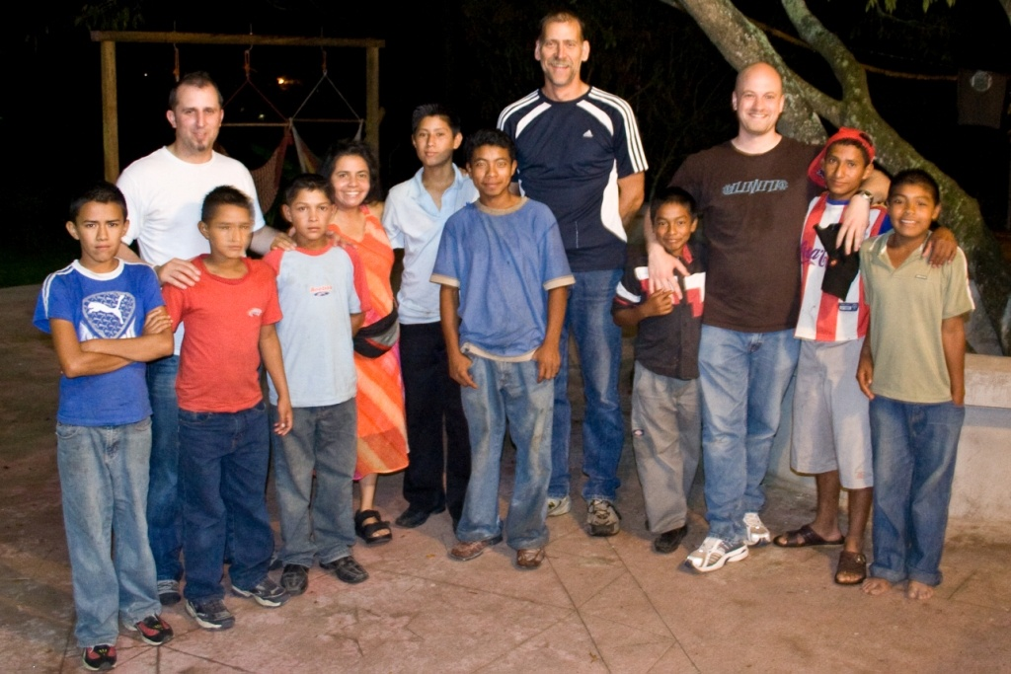
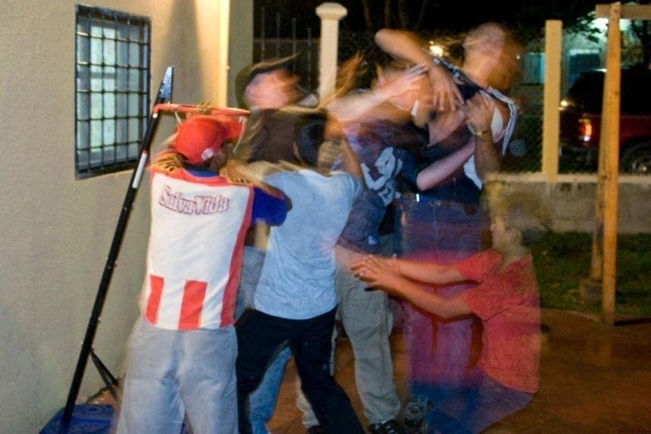
Outreach to Siguatepeque

Slide 11
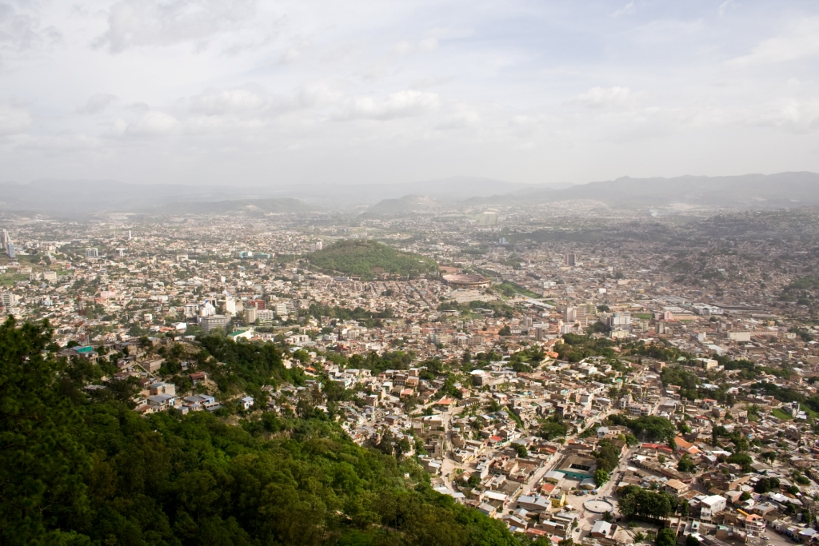
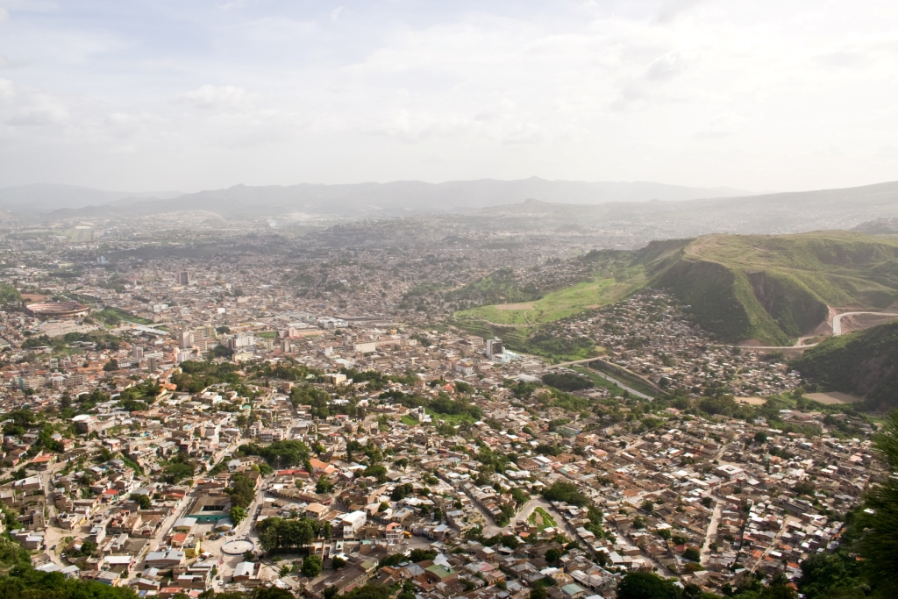
Isaiah 58:9b-10
“If you do away with the yoke of oppression, with the pointing finger and malicious talk, and if you spend yourselves in behalf of the hungry and satisfy the needs of the oppressed, then your light will rise in the darkness, and your night will become like the noonday.”
Teguc…

Slide 12
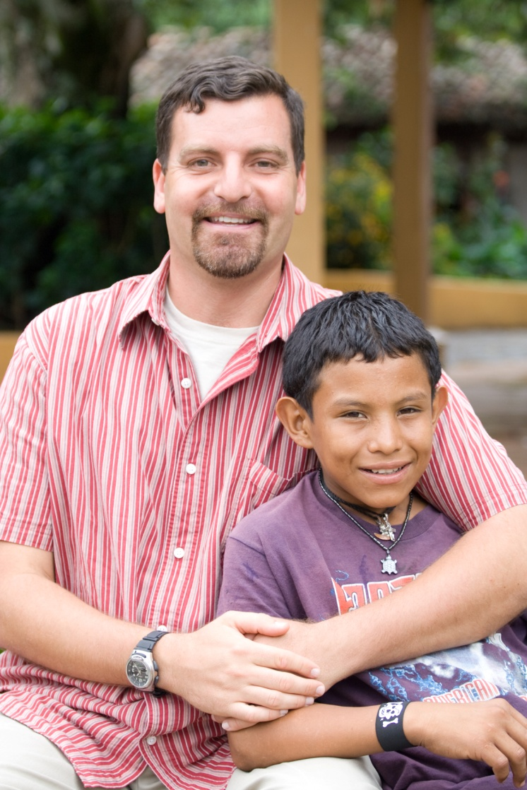
Michael Miller
Director of Micah Project

Slide 13
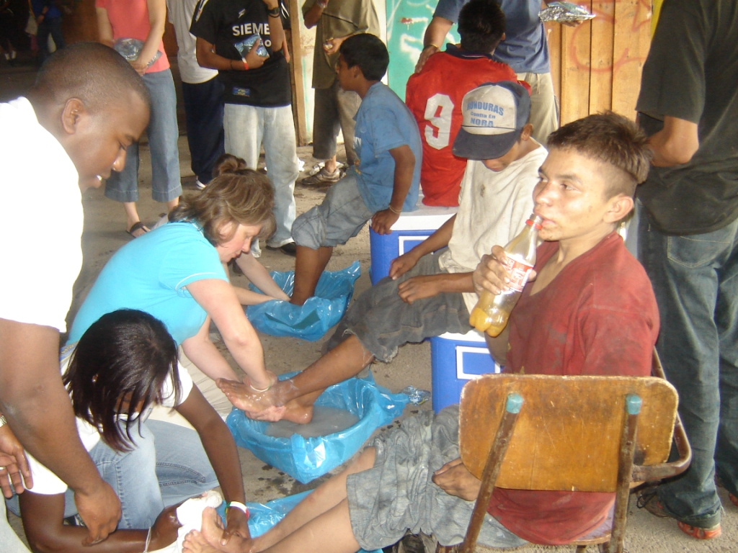
Micah Project: Street Ministry

Slide 14
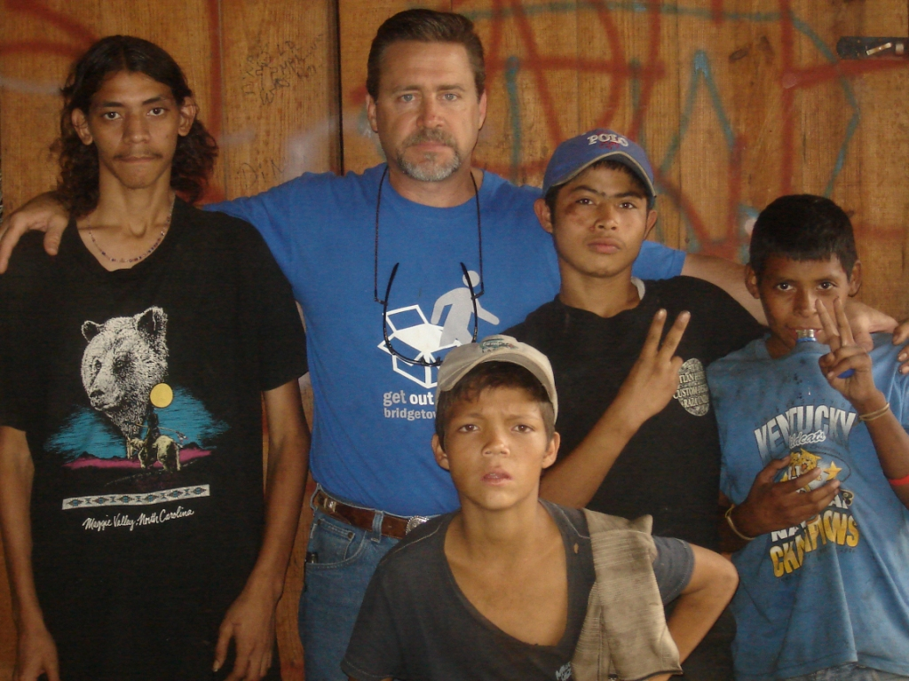
Micah Project: Street Ministry

Slide 15
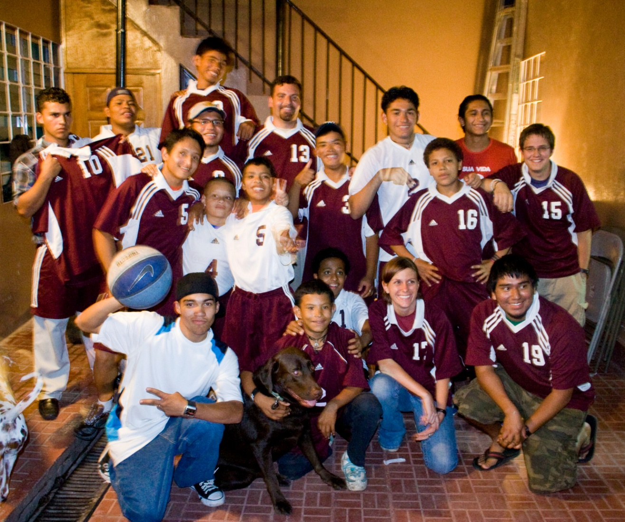
Micah Boys
Redemption…

Slide 16
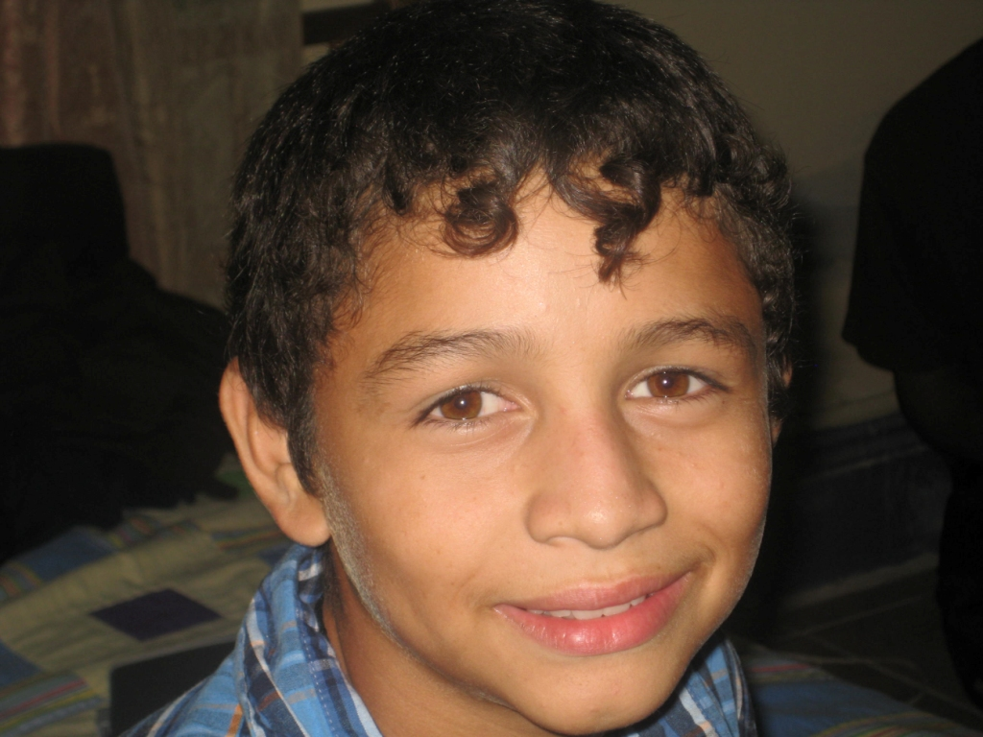
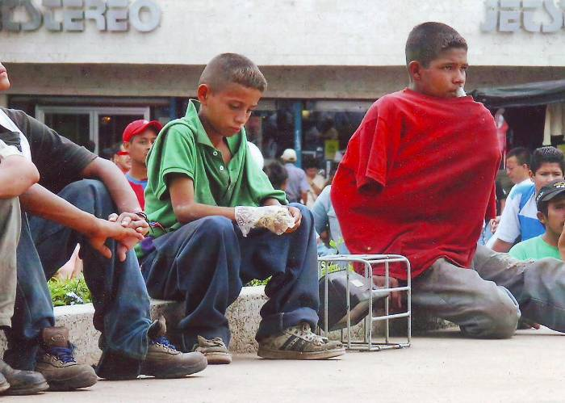
Marvin …

Slide 17
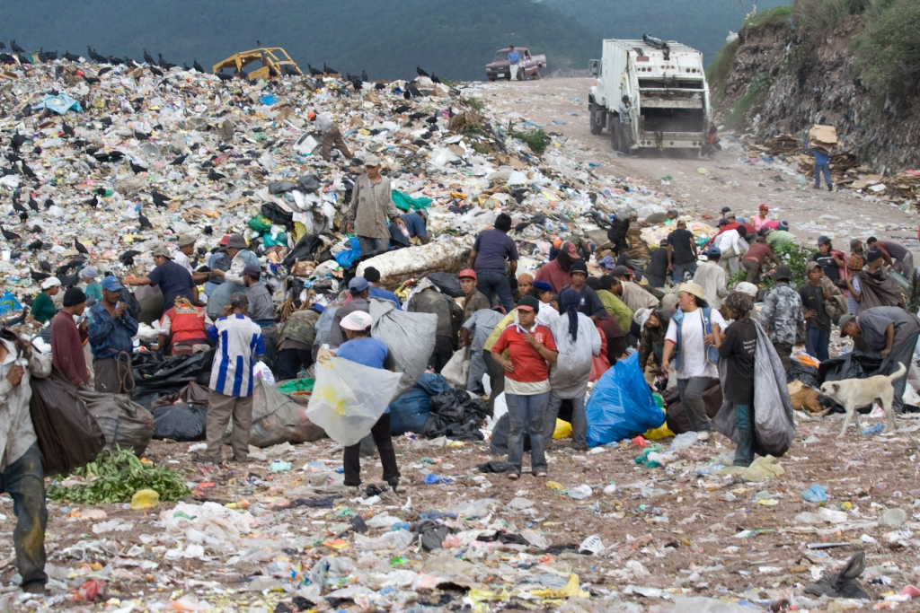
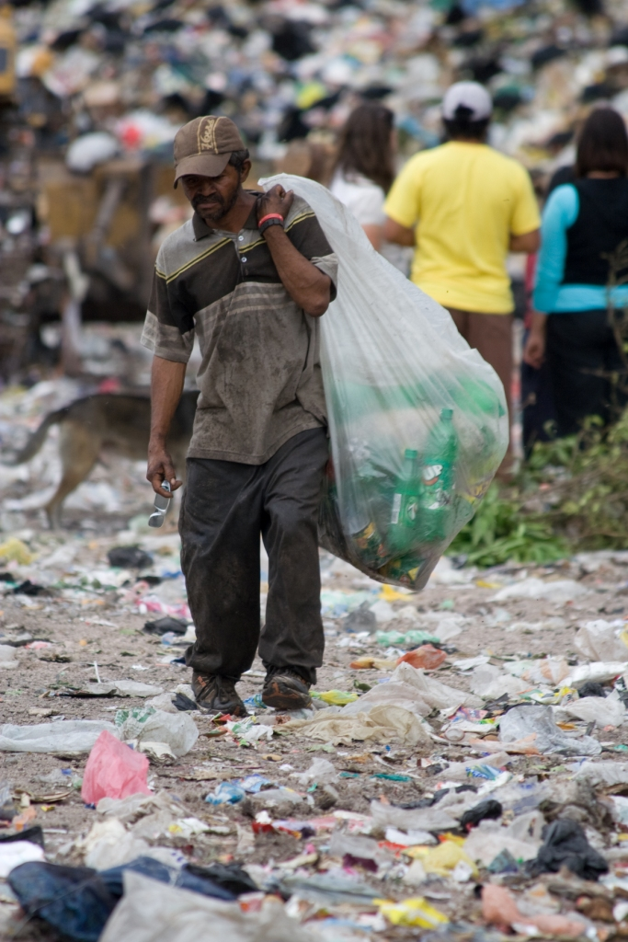
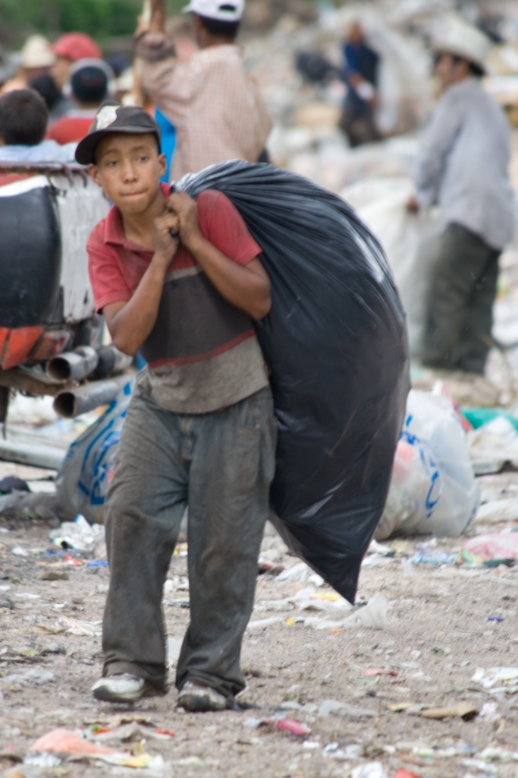
The Dump…

Slide 18
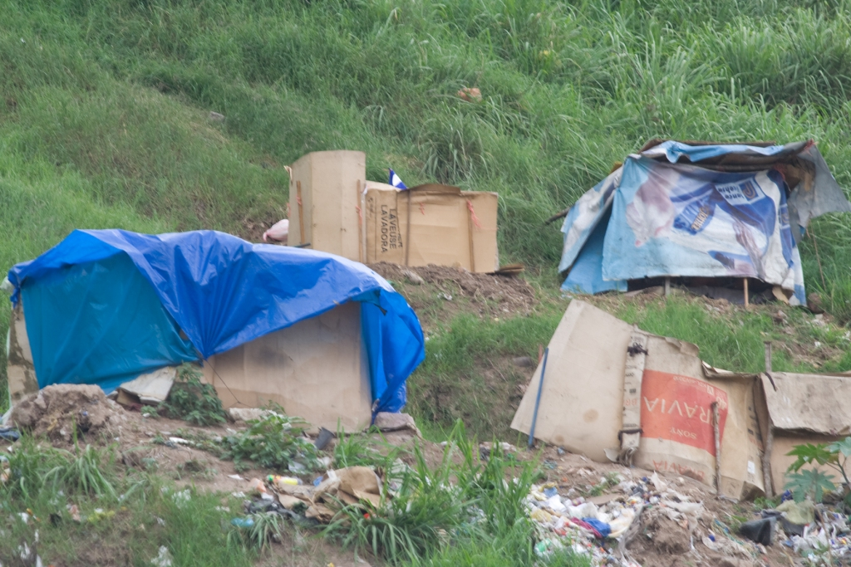
The Dump…

Slide 19
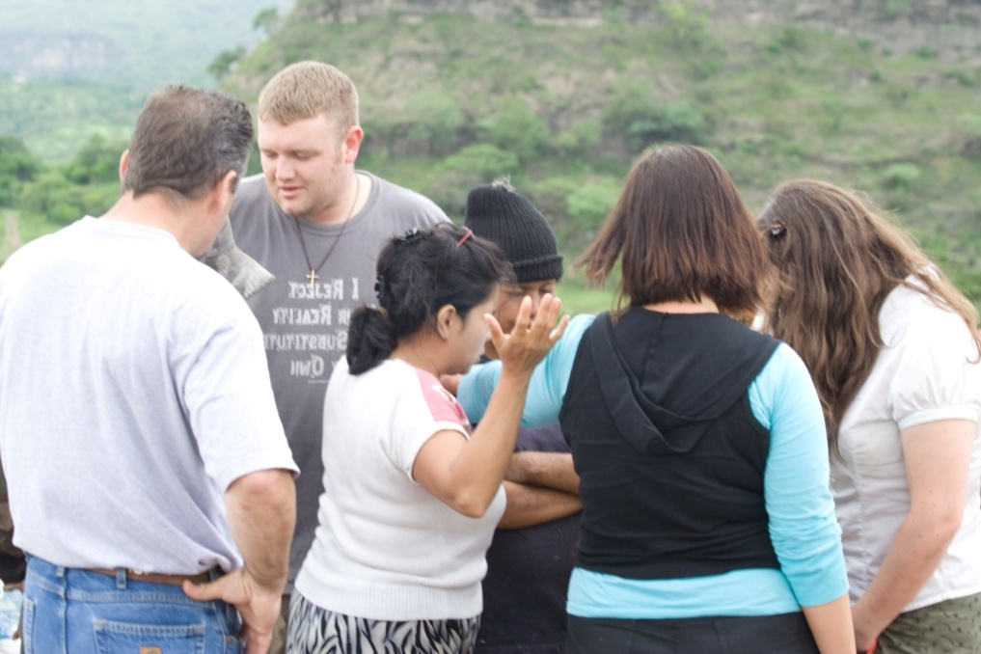
Releasing the oppressed…

Slide 20
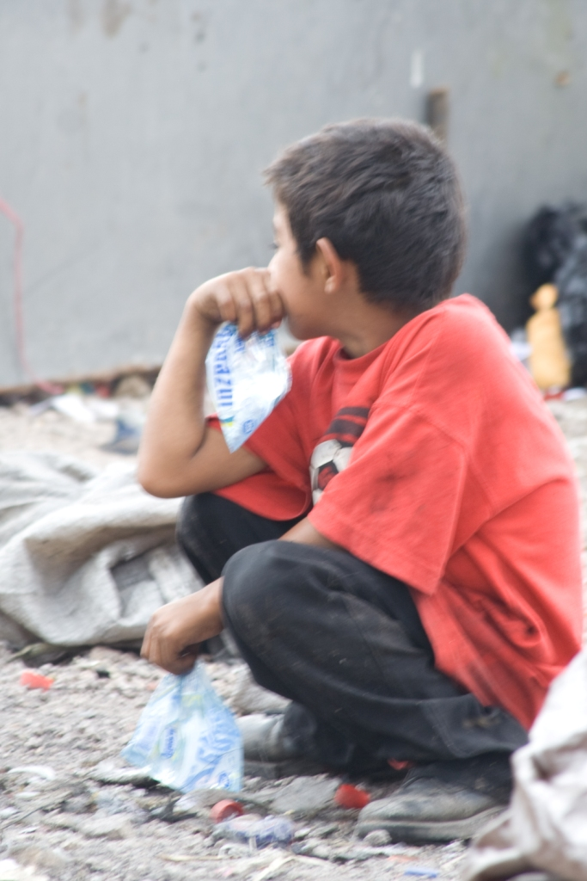
The Dump…

Slide 21
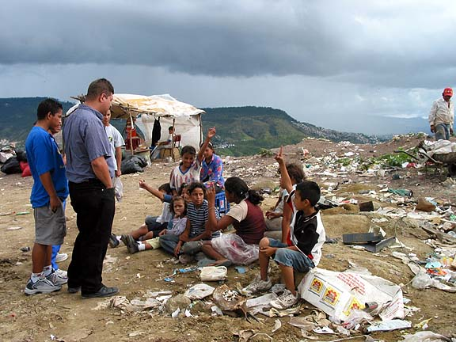
Releasing the oppressed…

Slide 22
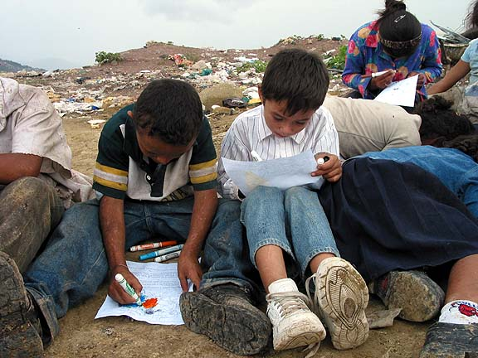
Releasing the oppressed…

Slide 23
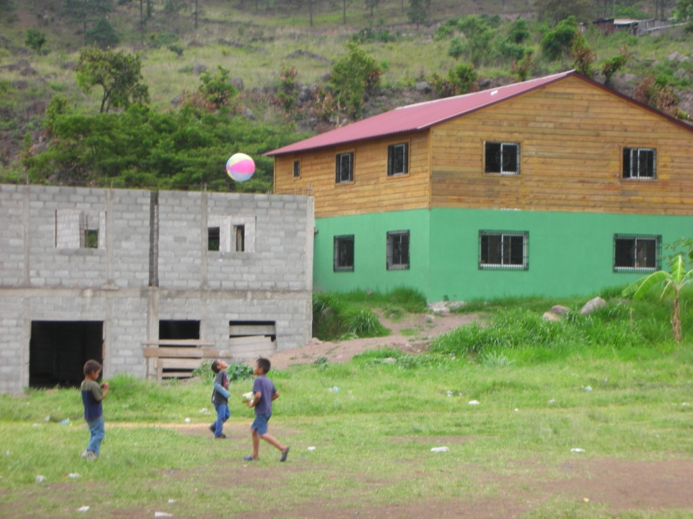
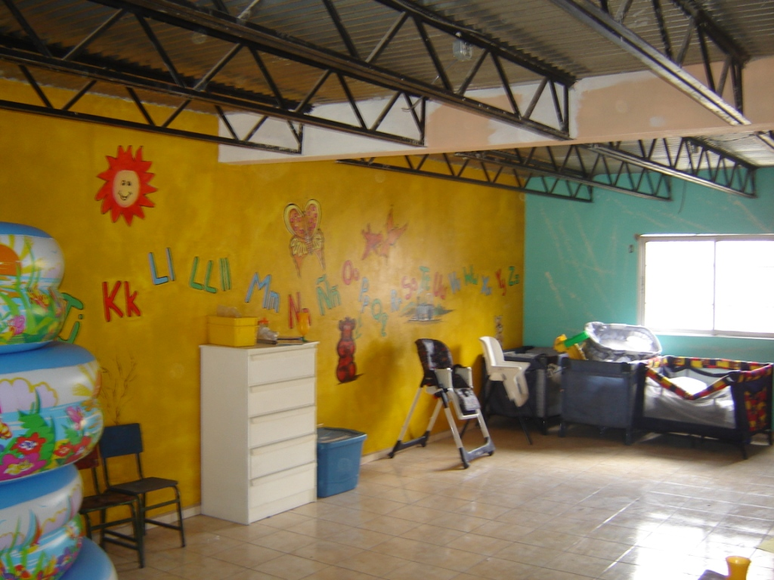
Hope for the future…AFE

Slide 24
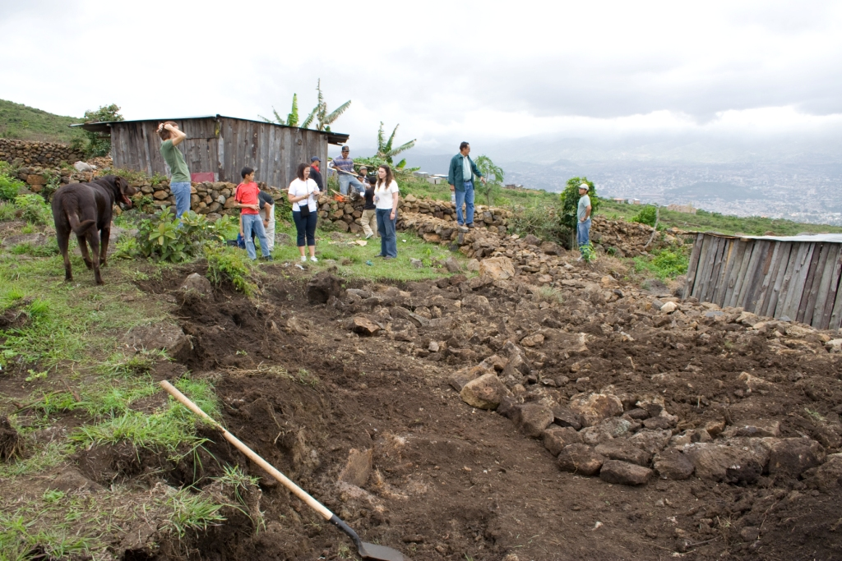
Building for the homeless.

Slide 25
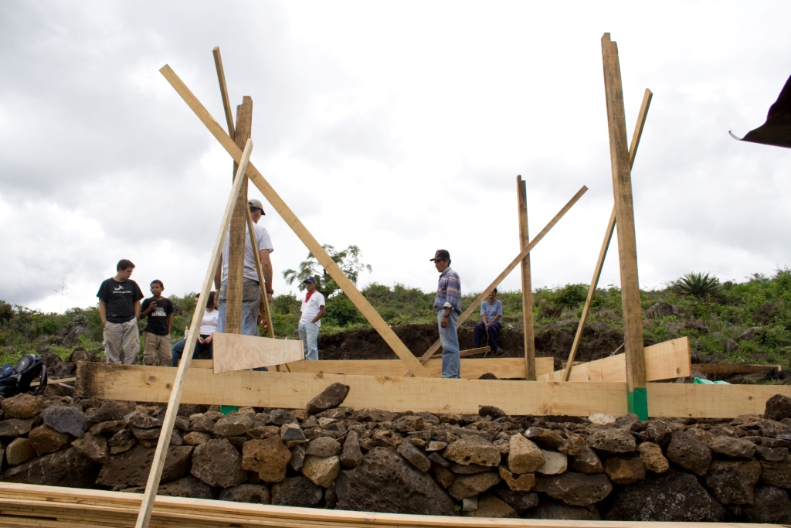
Building for the homeless.

Slide 26
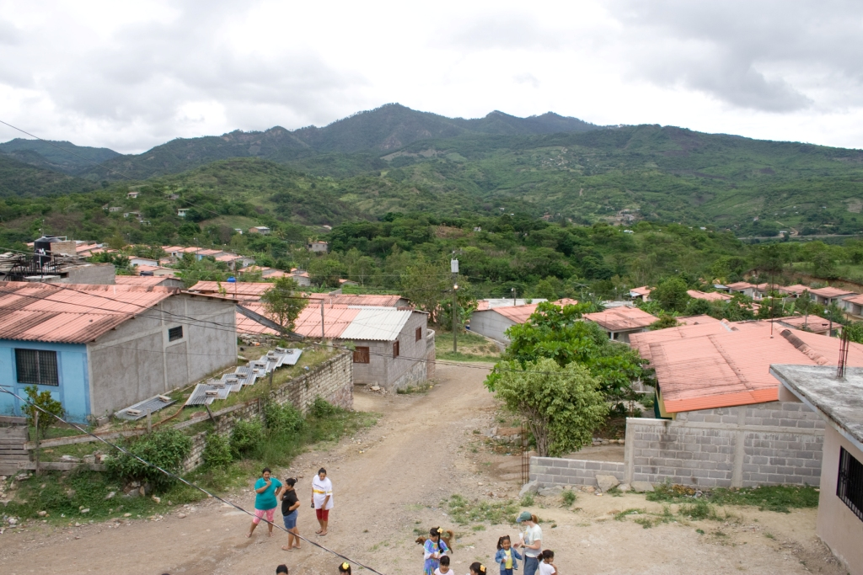
Villa Linda Miller

Slide 27
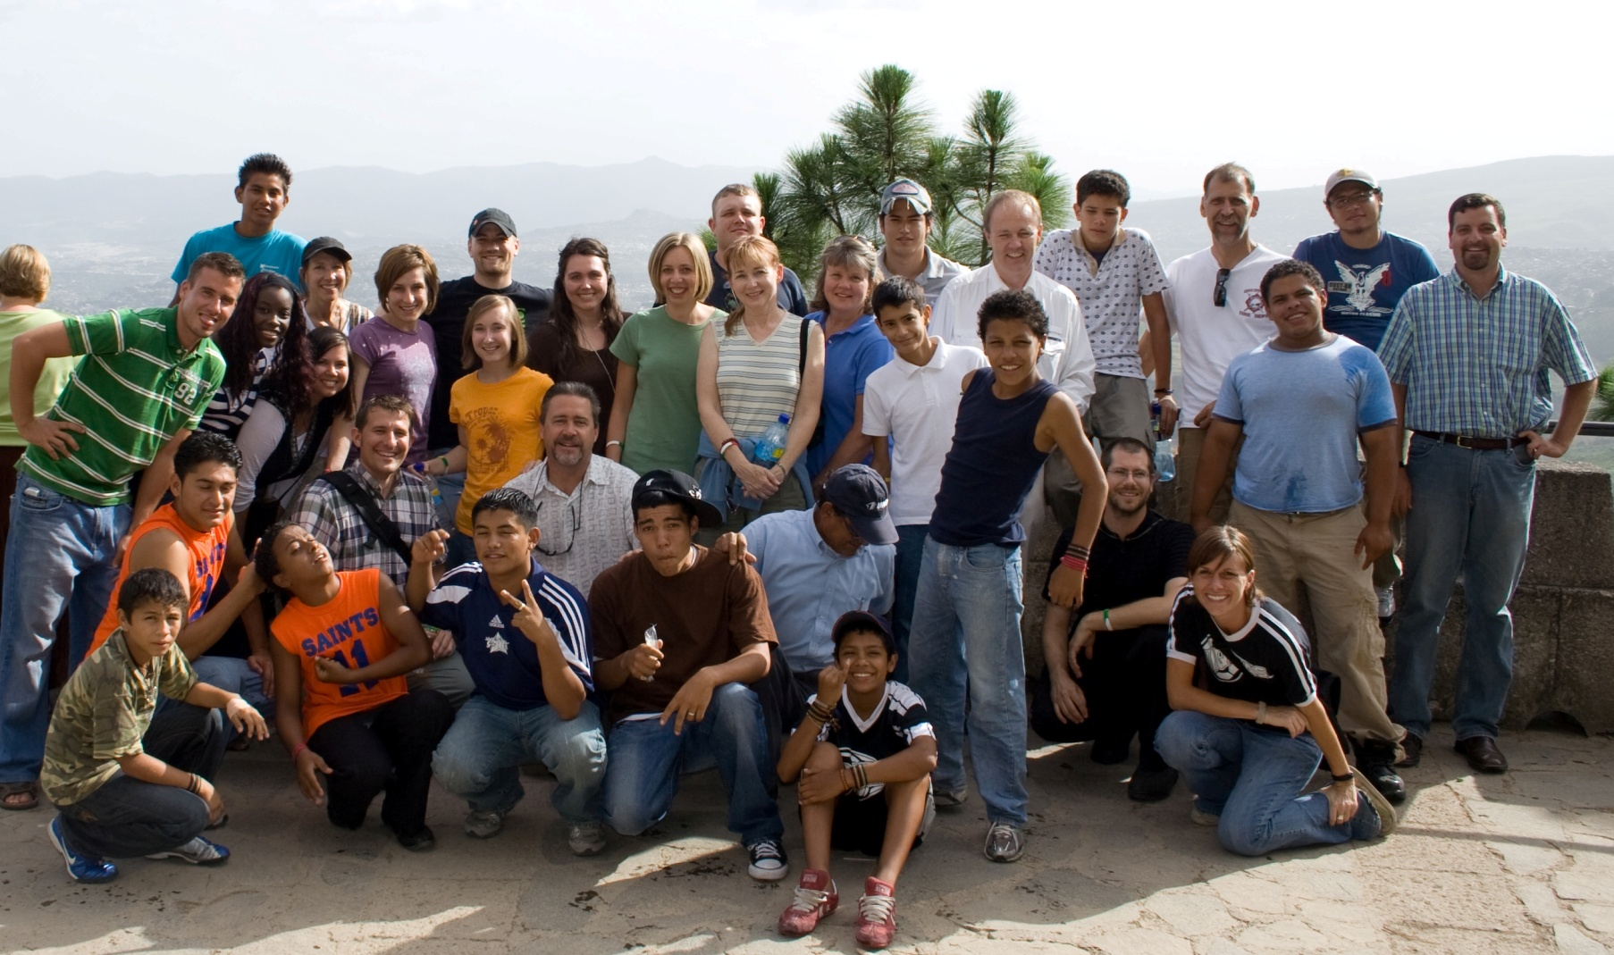
“You are the light of the world. A city on a hill cannot be hidden. Neither do people light a lamp and put it under a bowl. Instead they put it on its stand, and it gives light to everyone in the house. In the same way, let your light shine before men, that they may see your good deeds and praise your Father in heaven.” (Matthew 5:14-16)

Slide 28
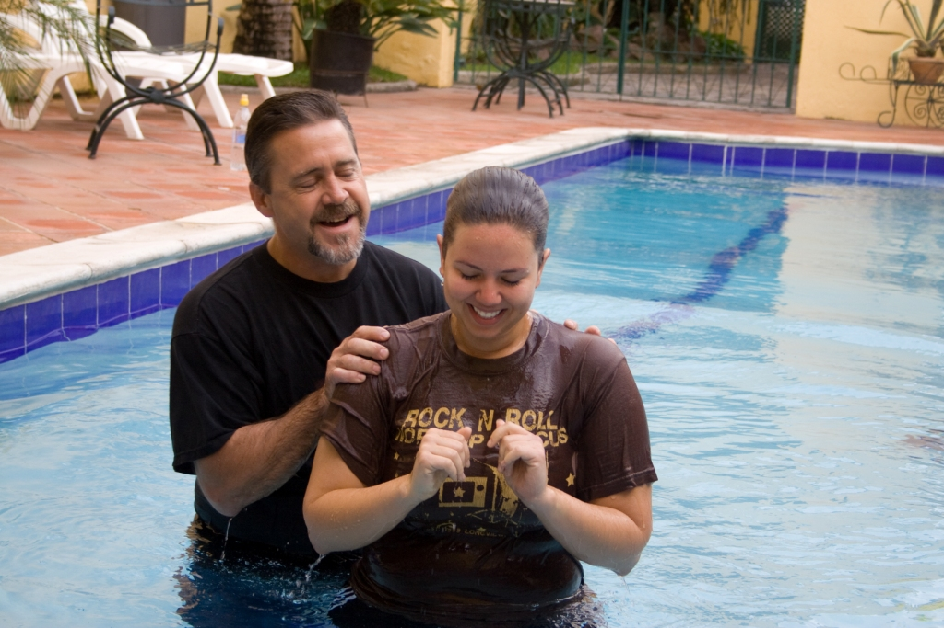
Baptisms
Amy Nielson

Slide 29
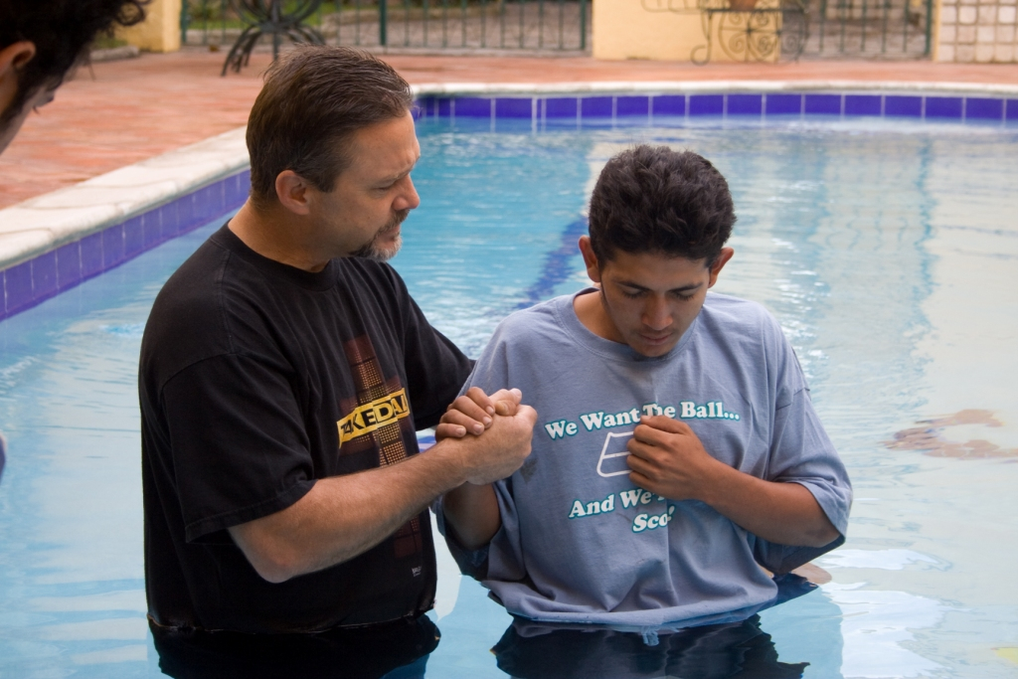
Baptisms
Marcio

Slide 30
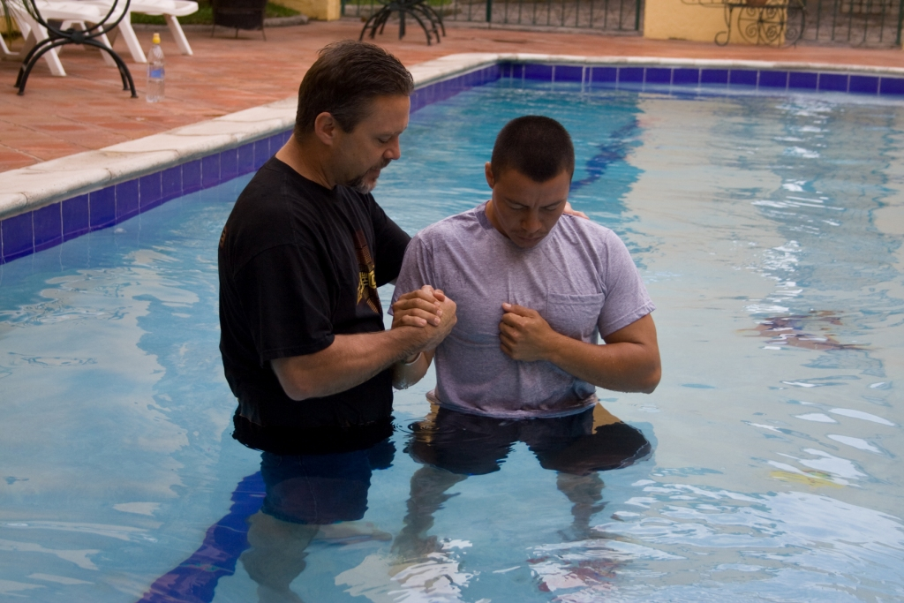
Baptisms
Juan Carlos

