Slide 1
Mexico Mission Trip 2008

Slide 2
Mexico Mission Trip 2008
This is what the LORD says: Do what is just and right. Rescue from the hand of his oppressor the one who has been robbed.
- Jeremiah 22:3a

Slide 3
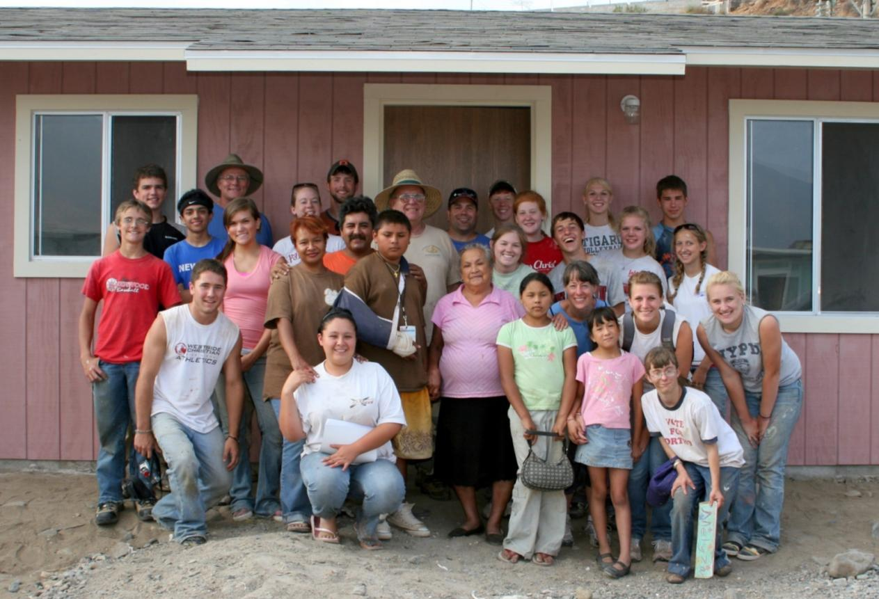
House Building

Slide 4
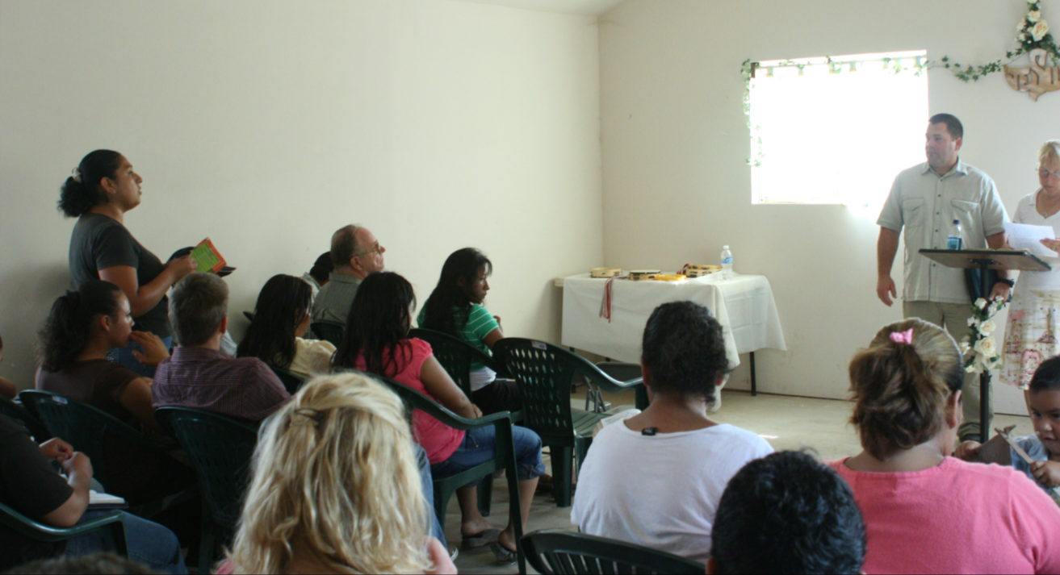
Church Ministry

Slide 5
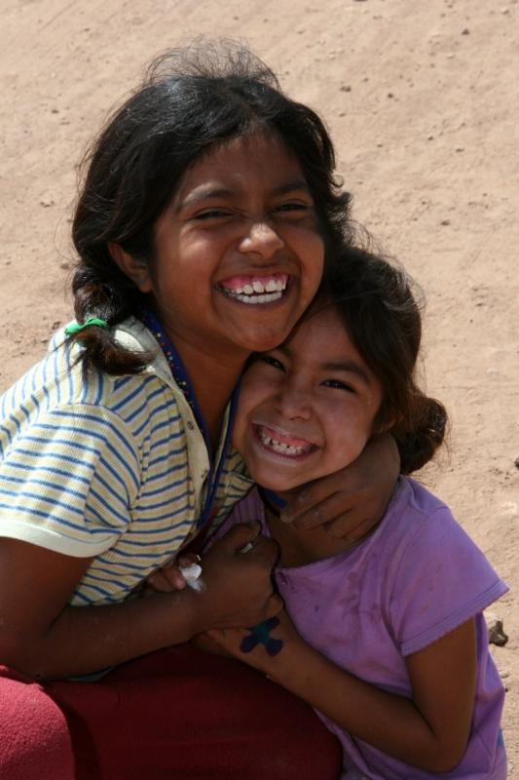
Photo Ministry

Slide 6
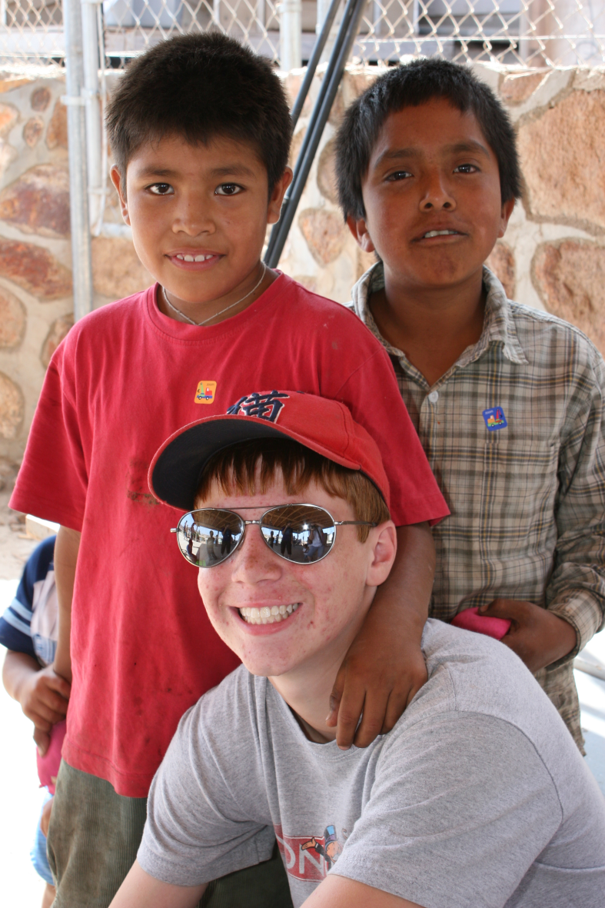
The Children

Slide 7
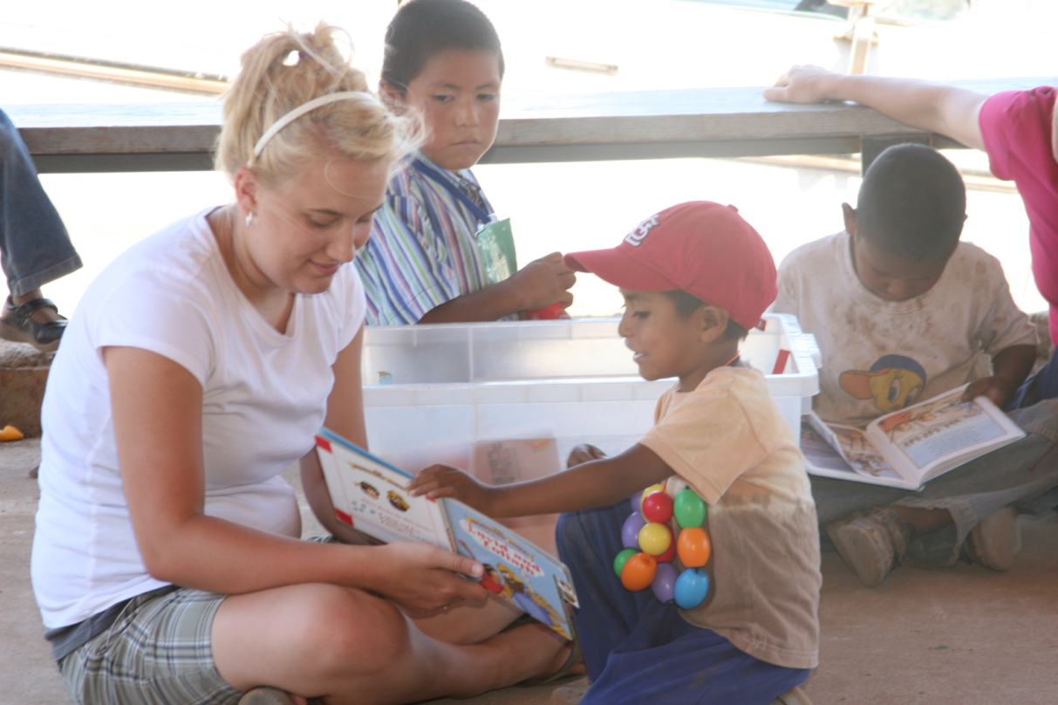
VBS

Slide 8
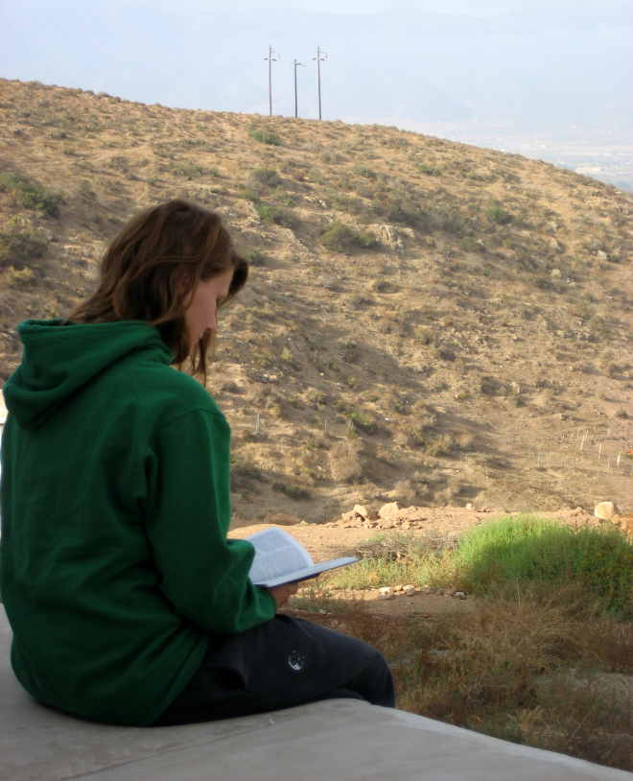
Daily Preparation

Slide 9
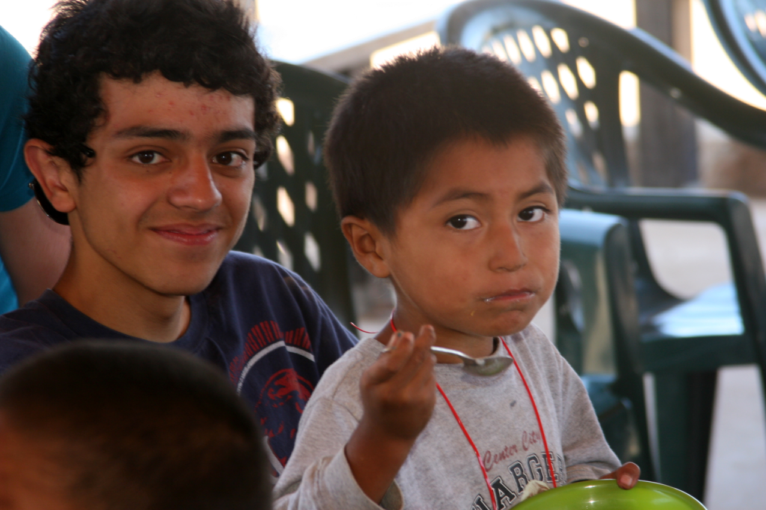
VBS

Slide 10
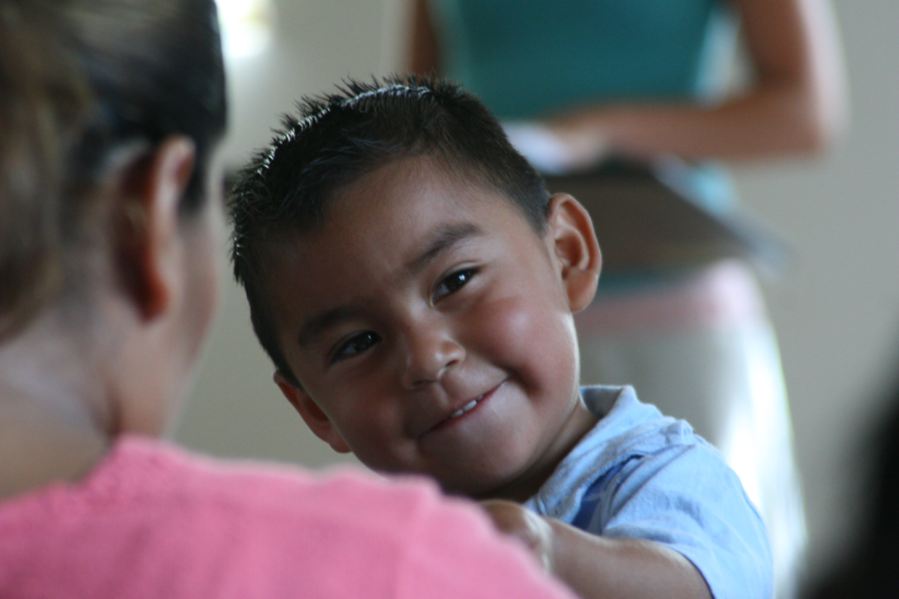
Joy in the Children

Slide 11
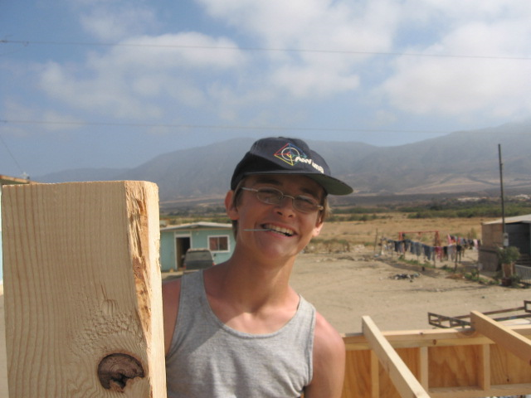
House Building

Slide 12
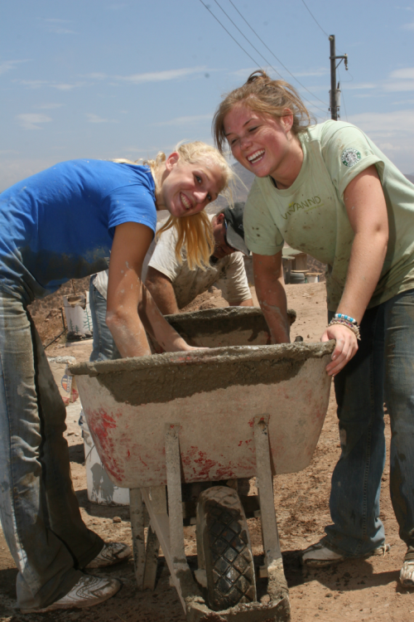
Cement Work

Slide 13
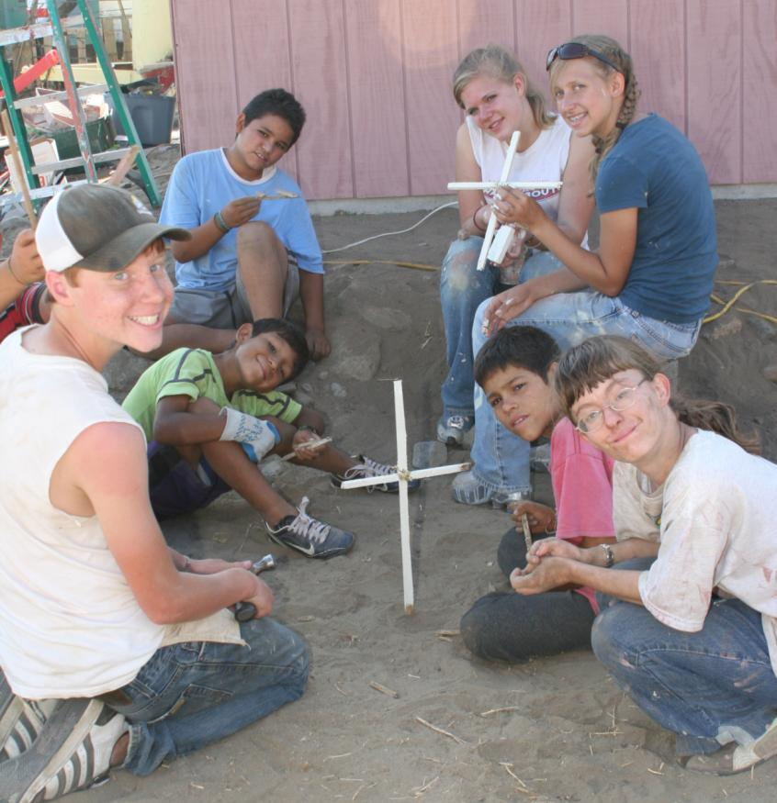
Playing with the Children

Slide 14
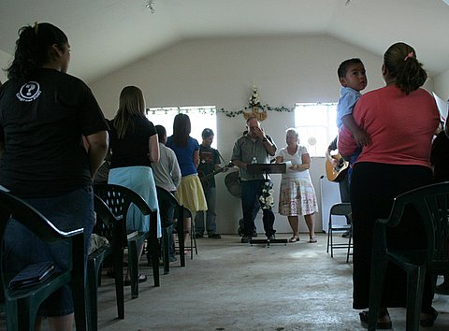
Tiling

Slide 15
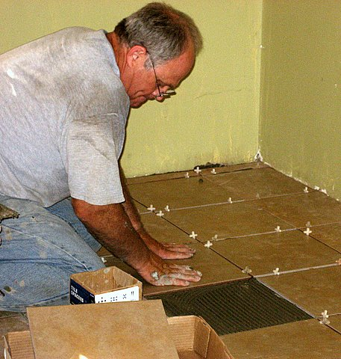
Tiling

Slide 16
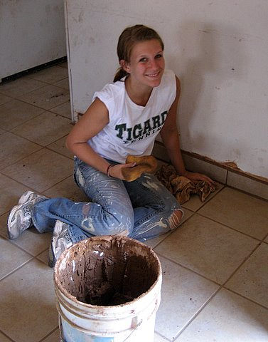
Tiling

Slide 17
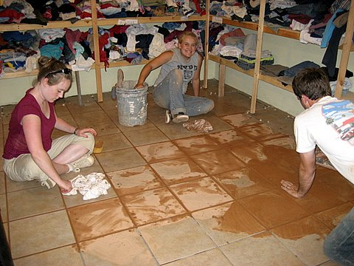
Tiling

Slide 18
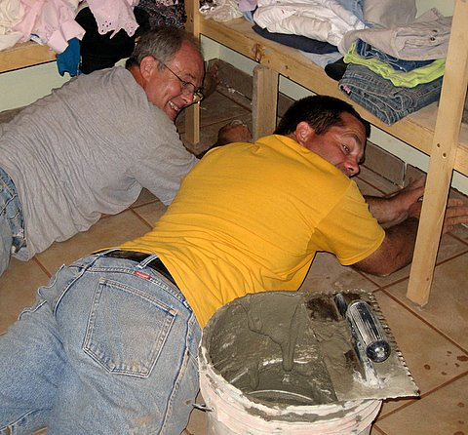
Tiling

Slide 19
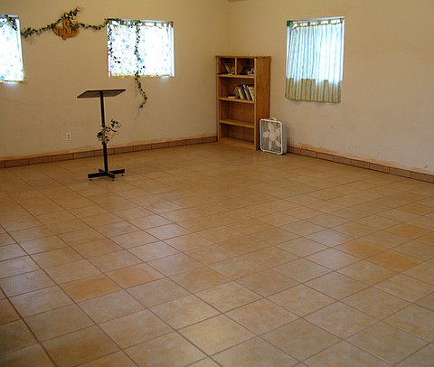
Tiling

Slide 20
Mexico Mission Trip 2008
When you spread out your hands in prayer,
I will hide my eyes from you;
even if you offer many prayers,
I will not listen.
Wash and make yourselves clean.
Take your evil deeds out of my sight!
Stop doing wrong, learn to do right!
Seek justice, encourage the oppressed.
- Isaiah 1:15a, 16-17

Slide 21
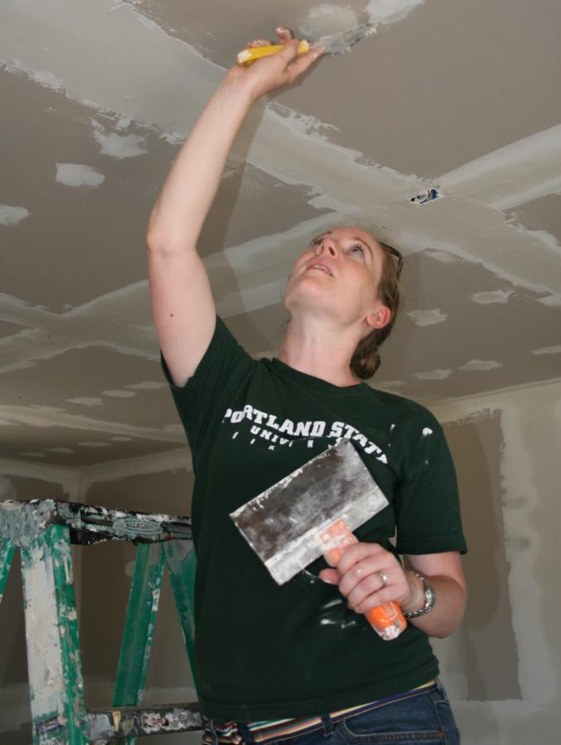
House Building

Slide 22
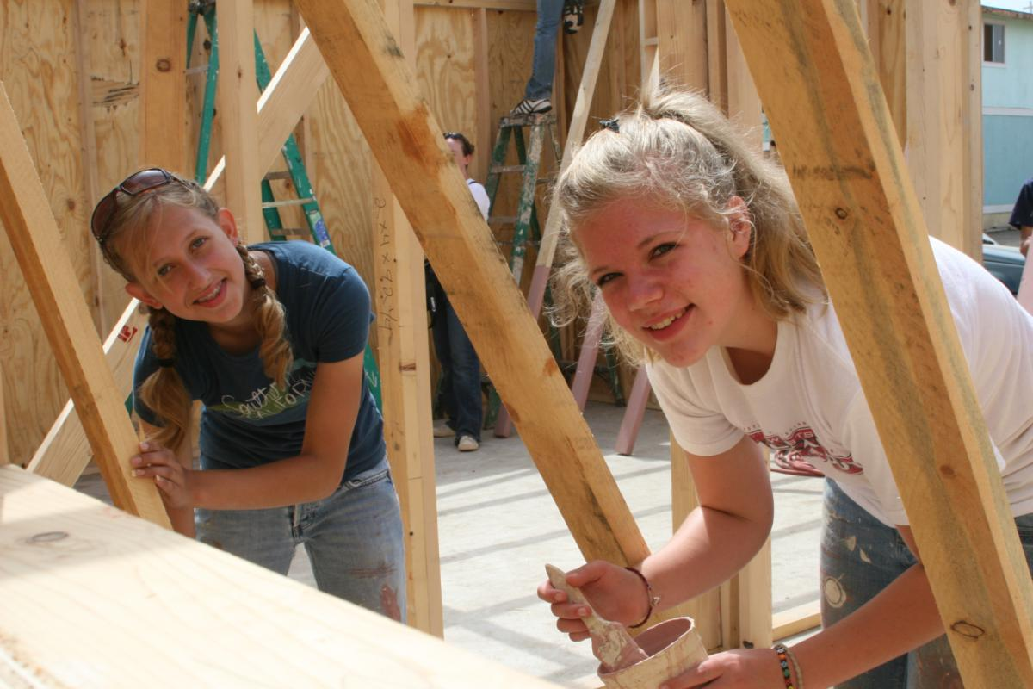
House Building

Slide 23
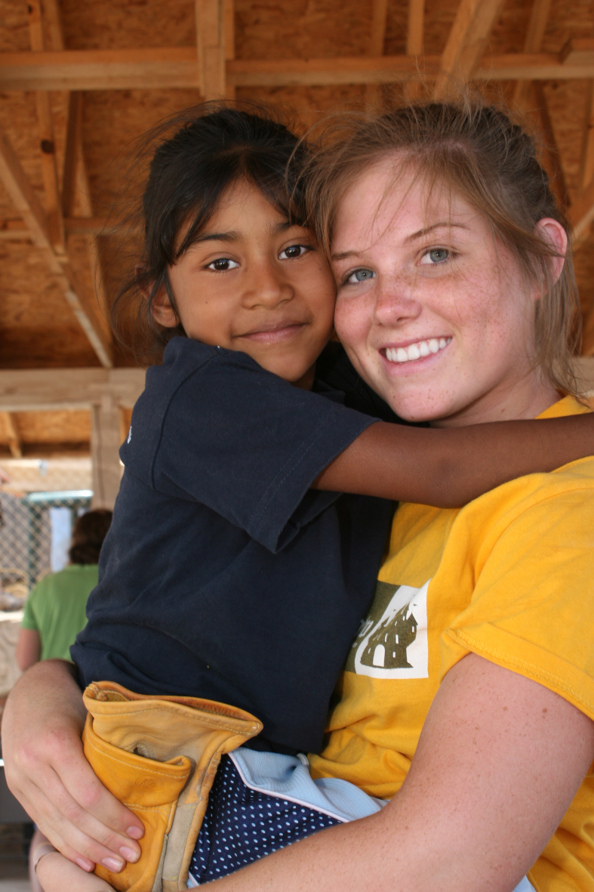
The Children

Slide 24
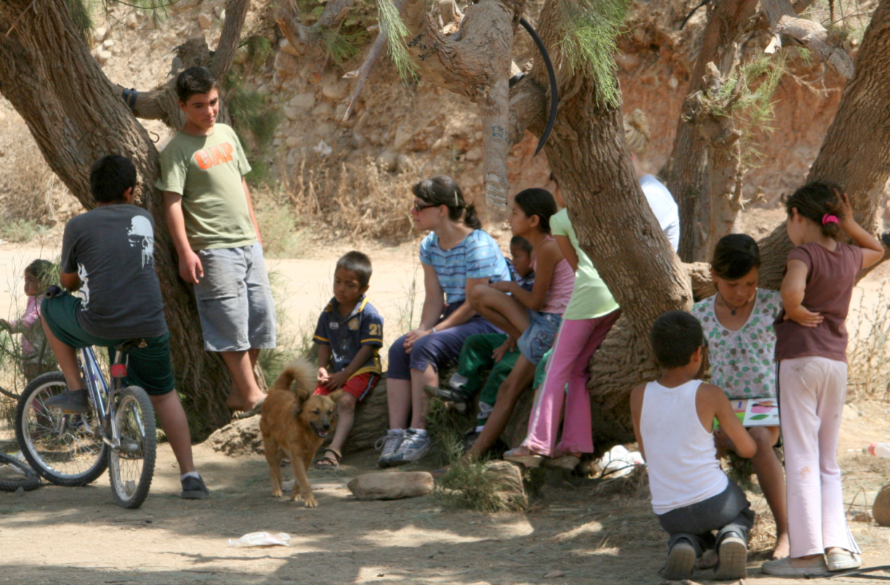
Children Around the House Build

Slide 25
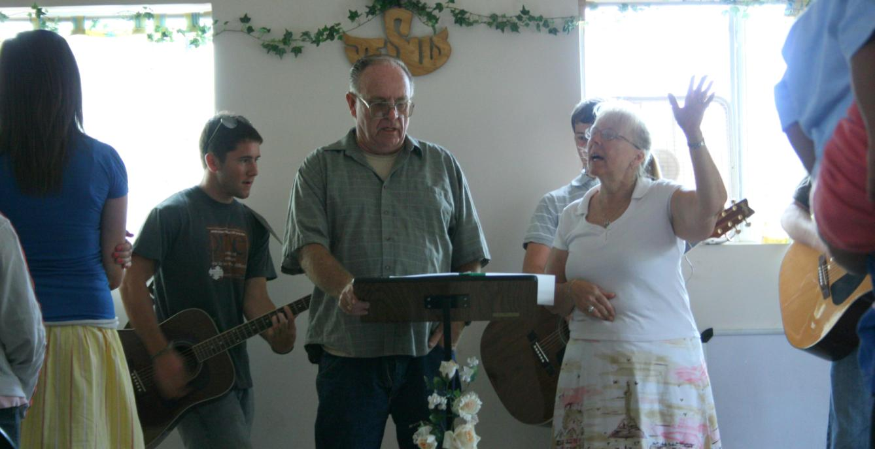
Worship at Church

Slide 26
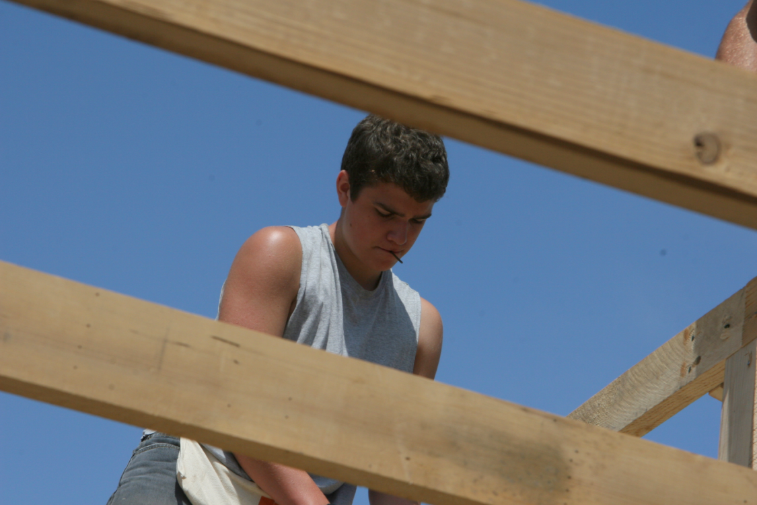
House Building

Slide 27
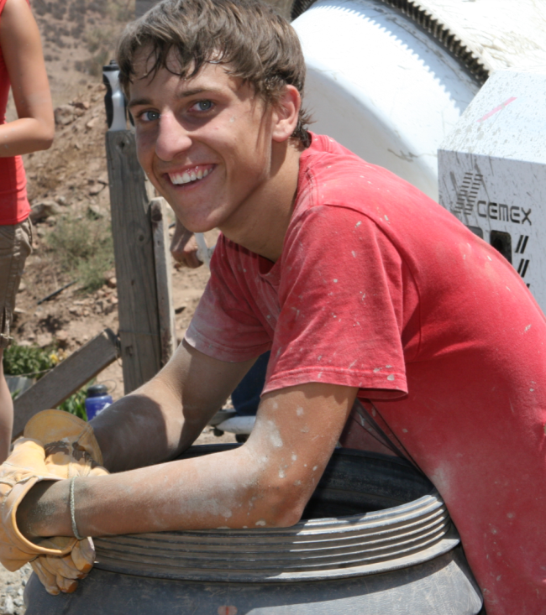
Cement Work

